Slide 1
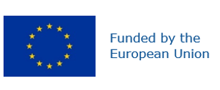
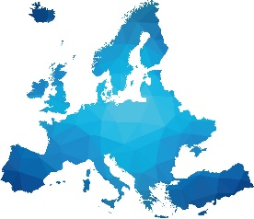
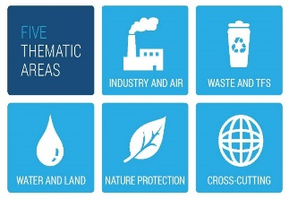
IMPEL
A view from IMPEL Practitioners on
Exchange of enforcement practices to drive Zero Pollution
Ana Garcia, IMPEL Chair
The Modus Operandi Of Italy And The Carabinieri Corps To Fight Illegal Landfilling –
Exchange of enforcement practices to drive Zero Pollution
Brussels, European Parliament, 7th February 2023

Slide 2
Enforcement from compliance chain is a key step
on implementation of legislation
IMPEL was set up in 1992 and is an international non-profit association with 56 Members from 36 Countries
Funded by Members and by the European Commission, IMPEL has more than 30 active projects within working groups, Water and Land, Industry and Air, Nature Protection, Waste and Transfrontier Shipment of Waste and Cross Cutting Issues; opportunity to access a pool of practitioner expertise who carry out practical implementation and enforcement on a day-to-day basis that come together towards our mission:
To ensure effective, efficient implementation and enforcement of European environmental law by promoting professional collaboration and sharing of information and best-practice between national, regional or local environmental competent authorities

Slide 3
Enforcement from compliance chain is a key step
on implementation of legislation
• Protection of human health, environment, and social and economical development (and public confidence), restoration of damage on affected sites/areas, level playing field (compliant operators cannot be at a disadvantage), also across continents;
• Compliance chain targeted coherent action on:
Prevention applied on early breaches: intelligence led action, self-monitoring/reporting from operators, geointelligence, big data, risk analysis, …
Stopping (potential) breaches: prevention and sanctioning of offences, restoration/correction; revision, suspension or revocation of permits; regulation improvements; feedback loop; …

Slide 4
IMPEL Multiannual
Strategic Work Programme (2022- 2027)
Understanding the implementation challenges and facilitate actions to close the gaps, under our 5 Expert Teams/ thematic areas;
Build strategic relationships between agencies and authorities at national, regional and local level within countries, across thematic areas and across the compliance chain -
Develop and build capacity in agencies and authorities.
Coordinating and carrying out Inspection & enforcement actions with transboundary relevance.
Improving outcomes and dissemination

Slide 5
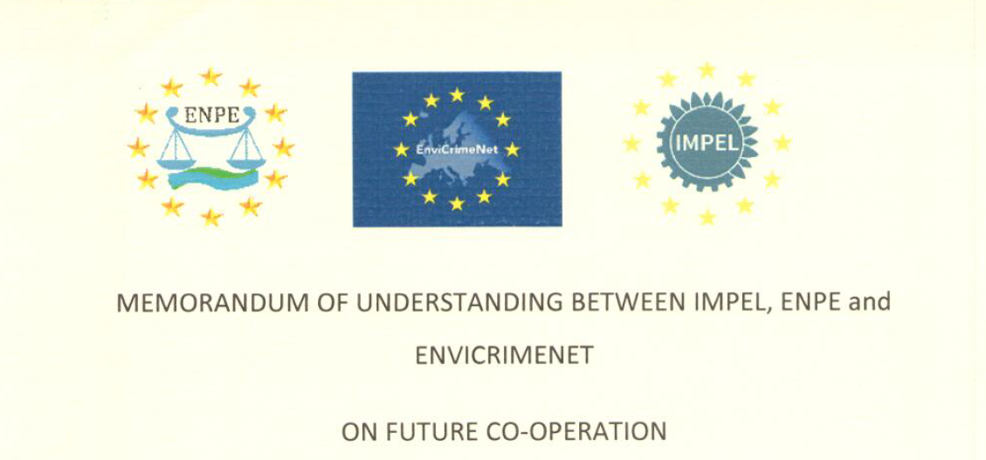
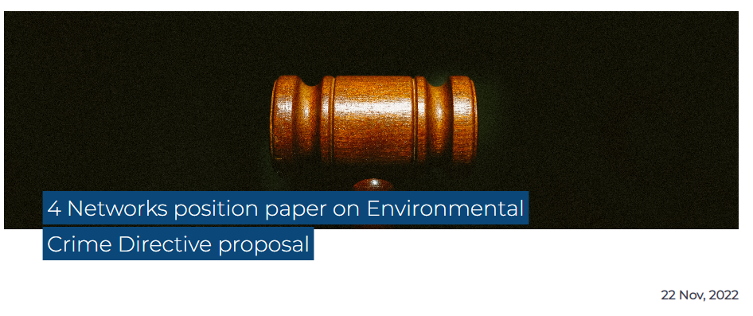
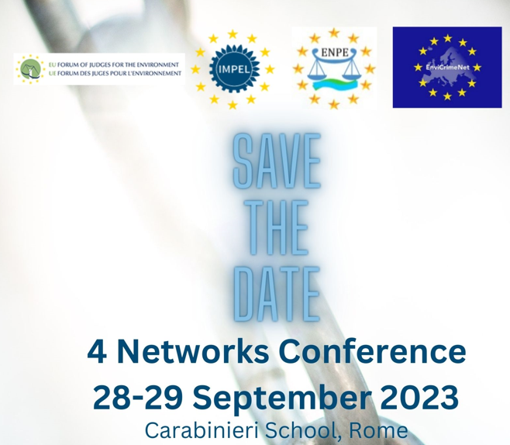
Build strategic relationships
Across compliance chain ↔
across national, regional and local level ↔ across thematic areas
4 Networks (IMPEL/EnviCrimeNet/ENPE/EUFJE)
MoU – Systematic cooperation and foster cooperation also at national level
Events to highlight case studies of good cooperation and best practice between permitters / inspectors, prosecutors, judges and police officers and lessons learnt
Participation in project working groups
European Commission and other EU institutions
Framework Partnership Agreement with European Commission
Participation in ECA Forum and meetings to discuss implementation topics
Contribution with practitioners’ views and feedback loop

Slide 6
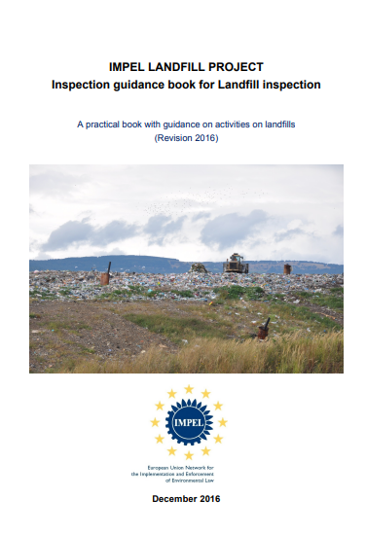
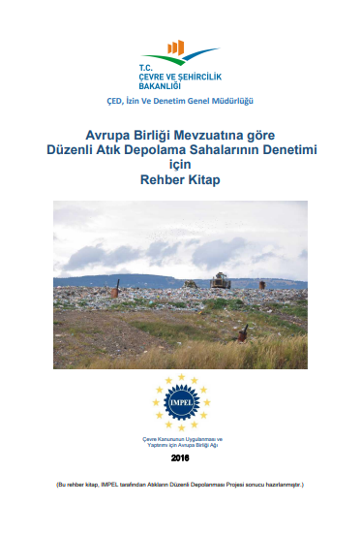
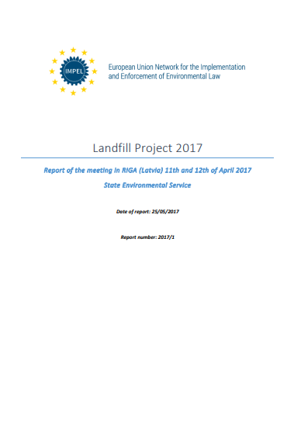
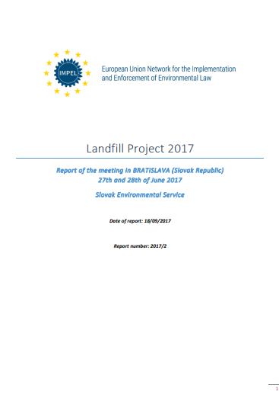
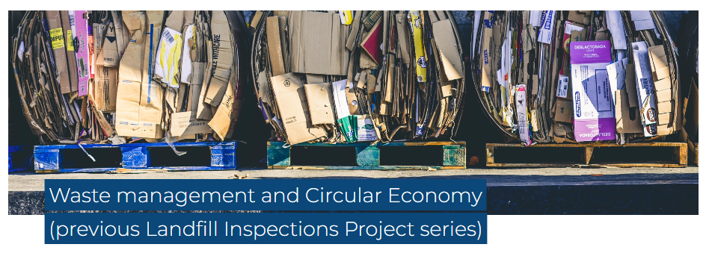
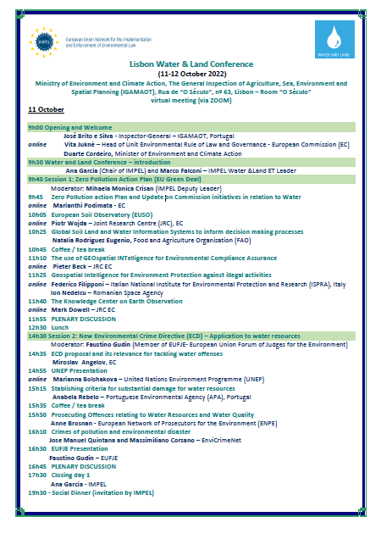
Build strategic relationships
Engaging with IMPEL Member Countries
Engagement meetings in IMPEL Member countries, with authorities to promote knowledge and involvement in IMPEL’s work and address our Members´needs
Support events hosted by Member Countries to contribute to foster cooperation with authorities between countries and within countries

Slide 7
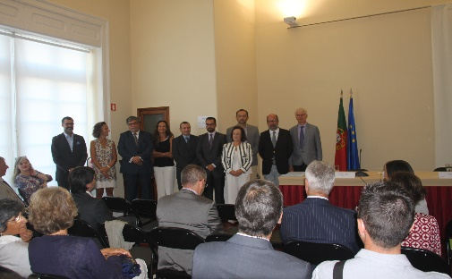
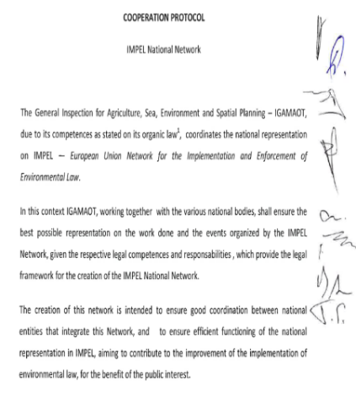
Build strategic relationships
IMPEL National Network
compliance chain authorities working together
Best national representation and multi-agency team contributions under IMPEL Projects and coordination of inter(national) projects, hosting events;
Monitor the work, promoting analysis and formulation of proposals and its implementation (strategic group)
Spread the most relevant work (annual conference) and annual public report

Slide 8
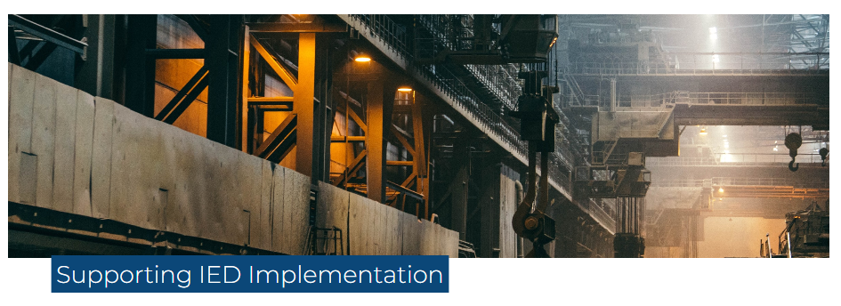
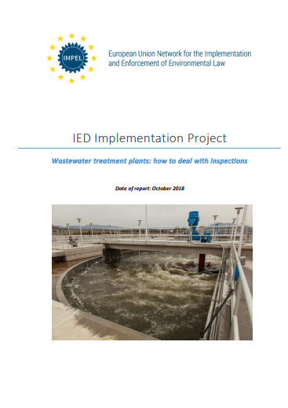
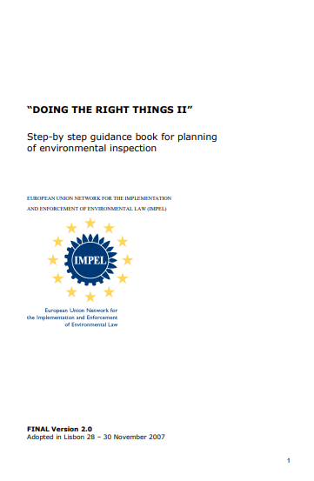
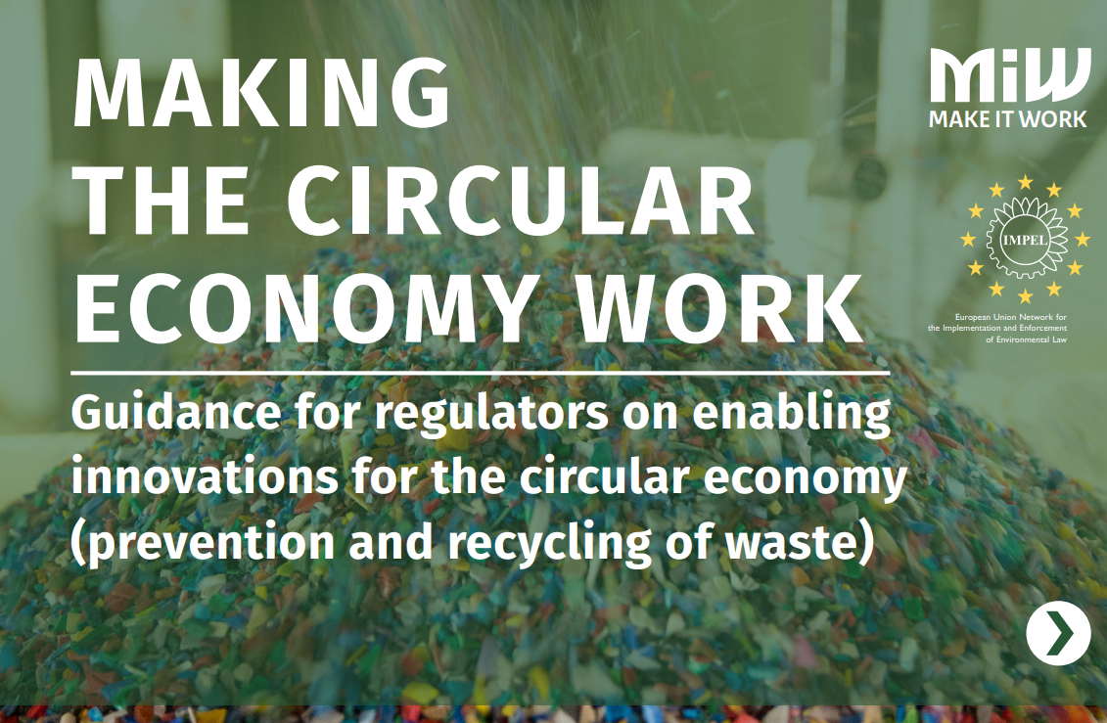
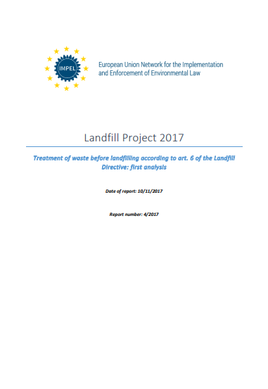
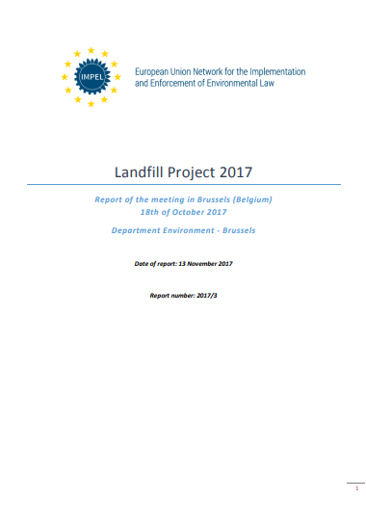
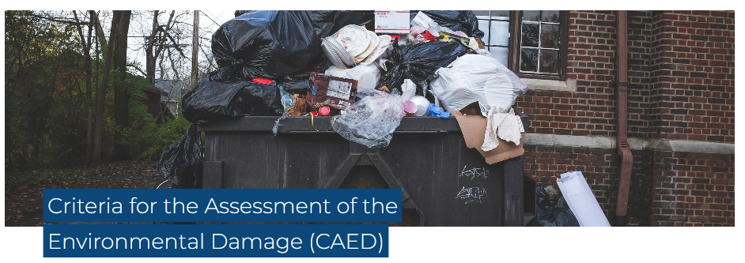
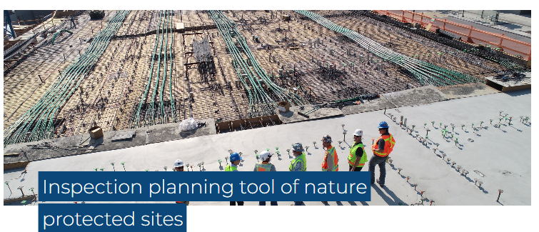
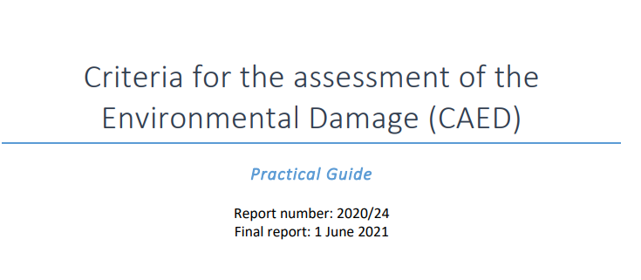
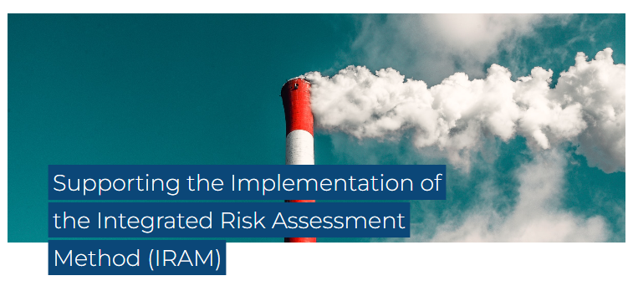
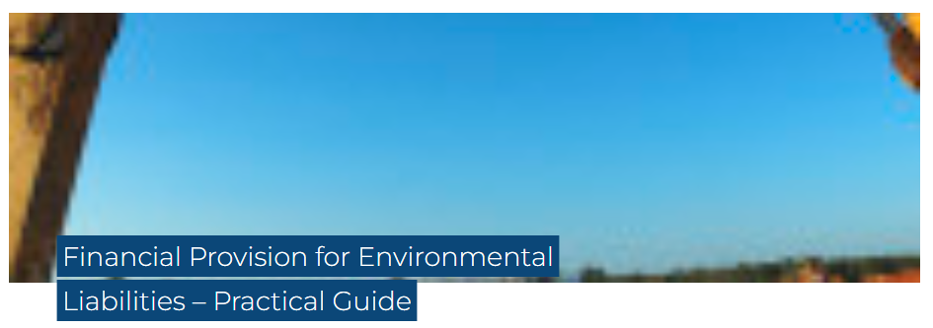
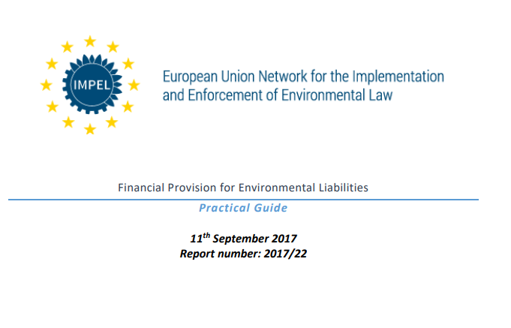
Develop and build capacity in agencies and authorities
(Tools/Guidances, just some examples)

Slide 9
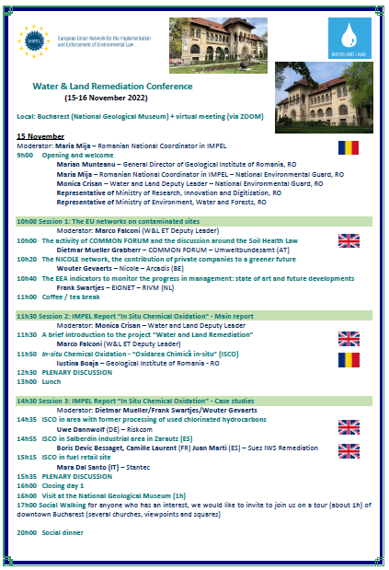
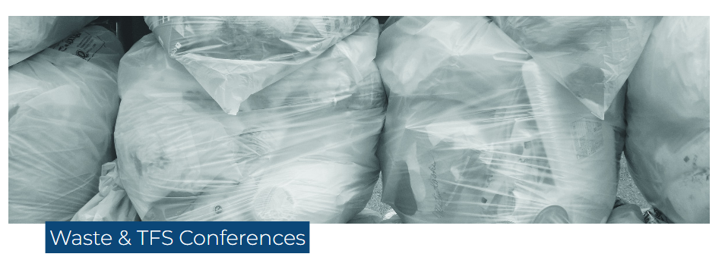
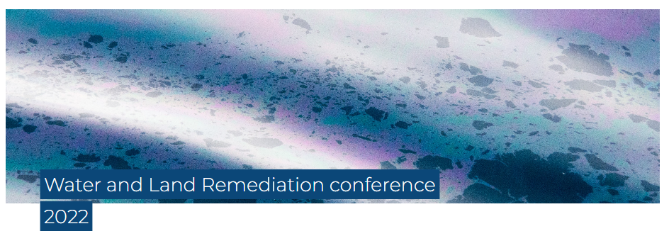
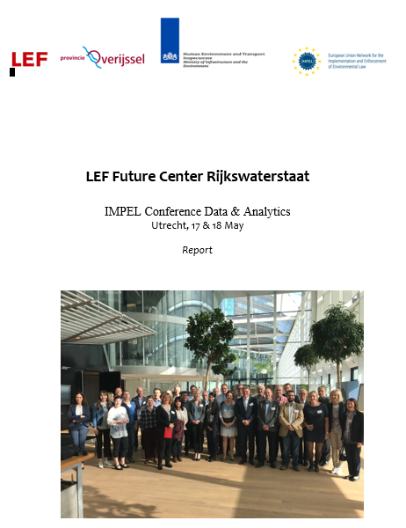
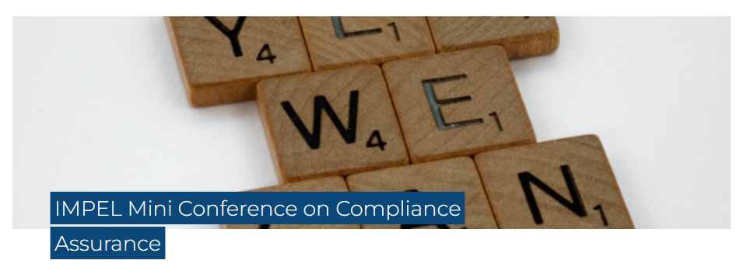
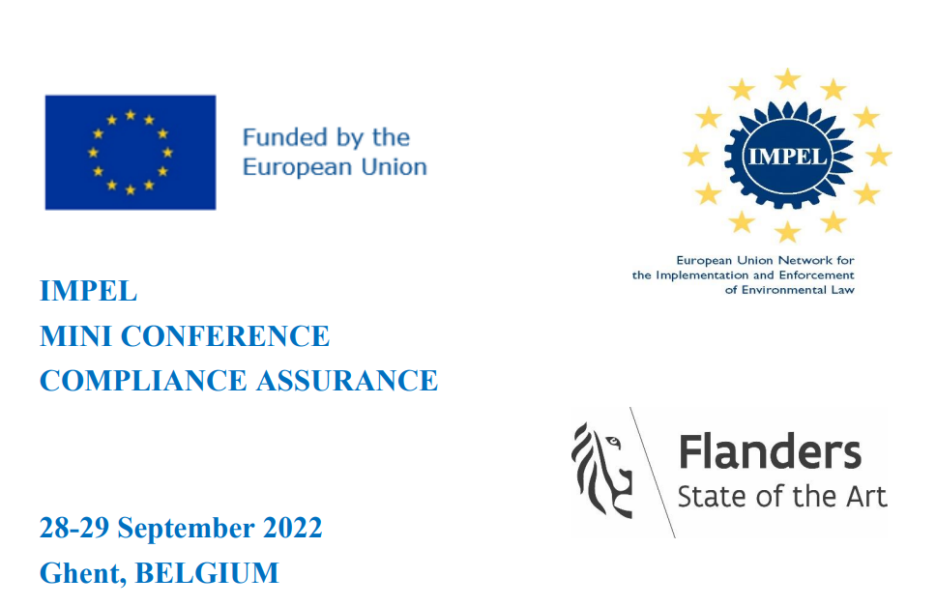
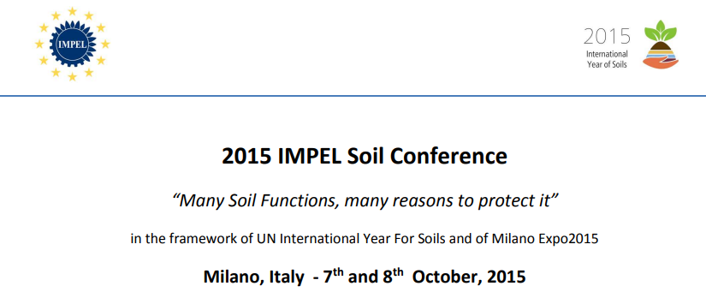
Develop and build capacity in agencies and authorities
(Conferences/Seminars/webinars)
Ministry for an ecological Transition
Handbook on monitoring from large vessels

Slide 10
Develop and build capacity in agencies and authorities
(IMPEL Review Initiative – IRI and National IRI)
The IRI is a voluntary scheme providing for Expert external informal peer reviews of environmental authorities in IMPEL Member countries, but can also be at national level, for instance between regional authorities:
Getting advice, broaden and deepen knowledge and understanding opportunities for development in structure, operation or performance
Encouraging capacity building and exchange of experience and collaboration on common issues and problems
spreading good practice leading to improved quality of the work and contributing to continuous improvement of quality and consistency of application of environmental law across the EU or at national level (“ level playing-field”)
Other Member States will benefit through the dissemination of the findings of the review through the IMPEL network
Yearly a number of IMPEL member countries volunteer for an IRI programme

Slide 11
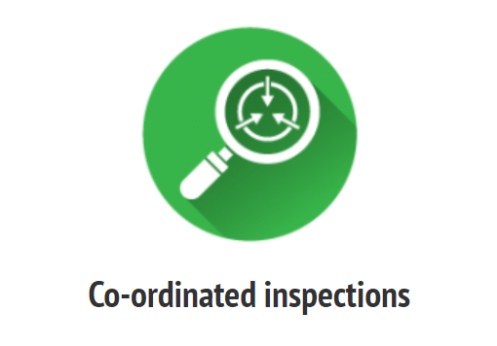
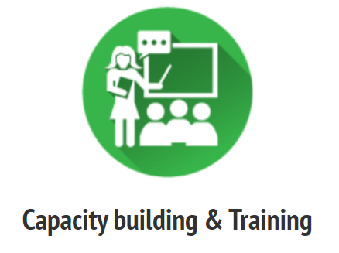
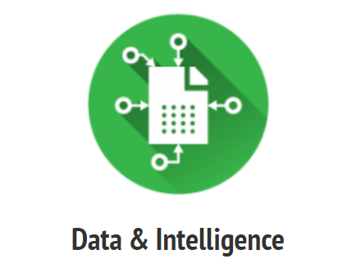
Coordinating and carrying out Inspection & enforcement actions with transboundary relevance
Targeted Customs training (150 officers)
Inspector exchanges (30)
Inspection app
On-line training toolkit
Best practice meetings
Performance of EU co-ordinated inspections throughout the waste management chain
Increasing data-set by performing 45,000 inspections
“IMPEL members have an active participation in tackling illegal shipments of waste.”
Geographical mapping tool
GPS tracking
Reporting app
Data collection and analysis
Intelligence reports

Slide 12
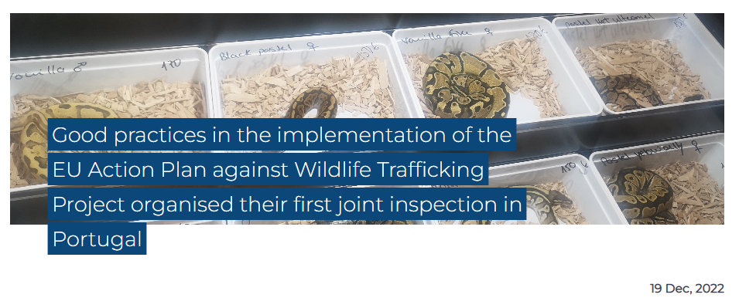
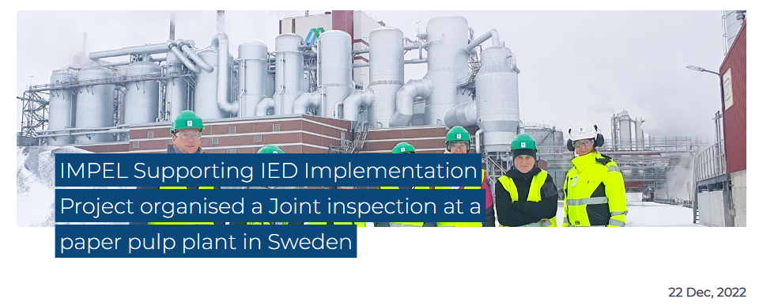
Coordinating and carrying out Inspection & enforcement actions with transboundary relevance
Joint inspections using the guide ‘Good practices in the implementation of the EU Action Plan against Wildlife Trafficking’, also to test and improve the guide, at 2 animal fairs.
Presentation of results by a webinar and report on main findings and best practices (there is often more than one solution to a ‘’problem’”)

Slide 13
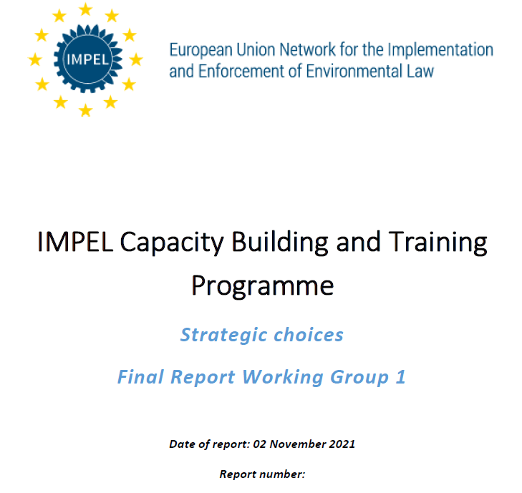
Improving outcomes and dissemination
(some examples)
Further improve and add more value to IMPEL products/ outputs by making more “user-friendly/fit-for-use” guidance materials and tools, integrating cross cutting aspects, streamlining and updating them and when necessary, transforming them into training materials and promoting webinars and e-learning to increase their uptake (hybrid and virtual participation to allow as wide participation by as possible).
Promoting and supporting country and authorities’ participation in IMPEL’s programme.

Slide 14
Thank you!
Email: info@impel.eu
Website: www.impel.eu
How can IMPEL help? More at https://player.vimeo.com/video/172708248?h=145e2672c5

