Slide 1
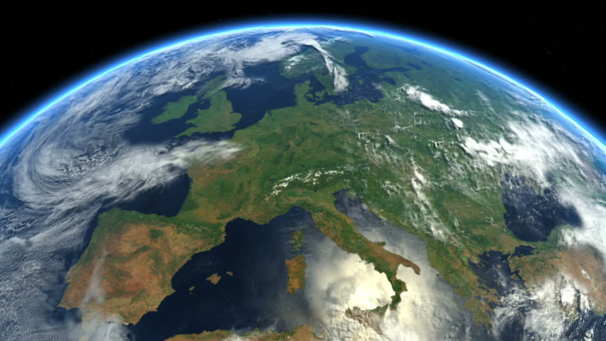

The European Federation of Geologists:
The Voice of Professional Geologists in Europe
David Govoni
President - Elect
European Federation of Geologists
Conference EU Infringement procedures on non-compliant Landfills
The modus operandi for crisis resolution of Italy and the Carabinieri Corps
European Parliament, Bruxelles – 7 February 2023
Notes:
I want to introduce you to an organisation working for our profession at the continent scale

Slide 2


Presentation Summary
1. Introduction of Euopean Federation of Geologists
2. Impact of Geologists in Landfills sector
3. Role of EFG in (No-sanitary) Landfills sector

Slide 3
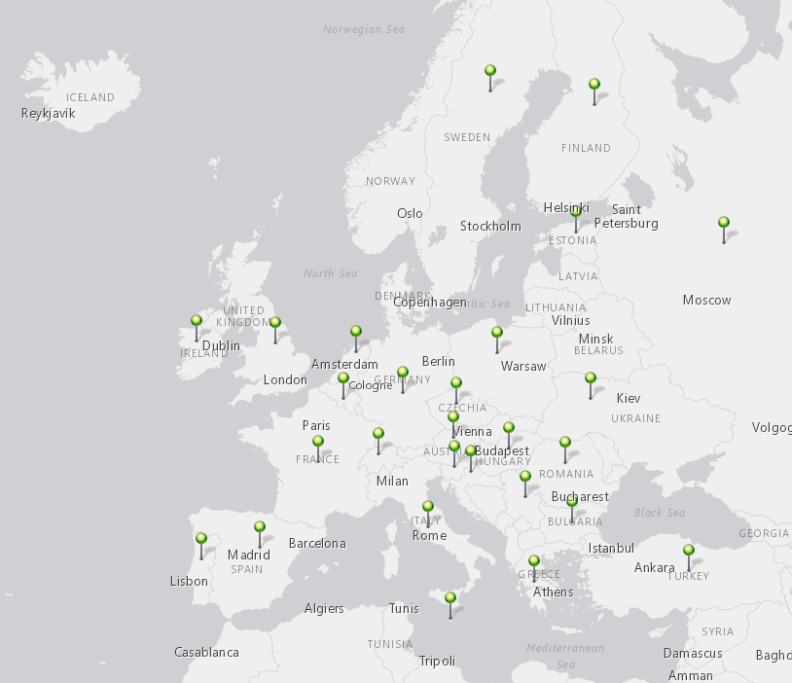

1.EFG: European Members
OUR MISSION
Represent formally the professional geoscience associations of Europe
Promote excellence in application of geoscience across the continent
Create public awareness of geoscience’s importance to European society
Austria
Belgium-Luxembourg
Bulgaria
Croatia
Czech Republic
Estonia
Finland
France
Germany
Greece
Hungary
Ireland
Italy
Malta
Netherlands
Poland
Portugal
Romania
Russia (suspended)
Serbia
Slovenia
Spain
Sweden
Switzerland
Turkey
Ukraine
United Kingdom
28 European national associations
Represent 45,000+ geologists
Includes continent’s largest & most prestigious professional societies
Geographically cover Azores to Arctic, Shetlands to Taurus Mtns.
Notes:
All about our members. Started from initiative to offer cross-European recognition of professional titles. Grown massively from there.
Latest member is Malta, who joined in early 2022.
You’ll note there’s a number of non-EU states shaded in blue and for our purposes this does not restrict us. Only issue is perhaps around ability to join EU Horizon Programme proposals

Slide 4
























1.EFG: Network and Projects
Participation in the global community and maintaining international networks
Delivery of 20+ EU-funded research & innovation projects in last decade
Memberships
Partnerships
Projects
ENGI
CRM-Geothermal
Global Geoscience Professionalism Group
Notes:
We are both Member and Partner of organisations

Slide 5
1.EFG: Expert Panels
^{CO2 Geological Storage}
^{Education}
^{Geoheritage}
^{Radioactive Waste}
^{Geotechnics}
^{Geothermal Energy}
^{Hydrogeology}
^{Natural Hazards}
^{Minerals}
^{Soil Protection}
Providing independent reliable information on geoscience technical topics
Audiences among European institutions, international NGO’s, project developers & global professional associations
Encourage collaboration among professionals from different countries working in same topic area

Slide 6
2. Impact of Geologists in Landfill sector: provide crucial expertise in operations
  evaluating the geology, hydrogeology, pedology
  development and implementation of the EMS environmental management system
  design closure and post-closure plan.

Slide 7
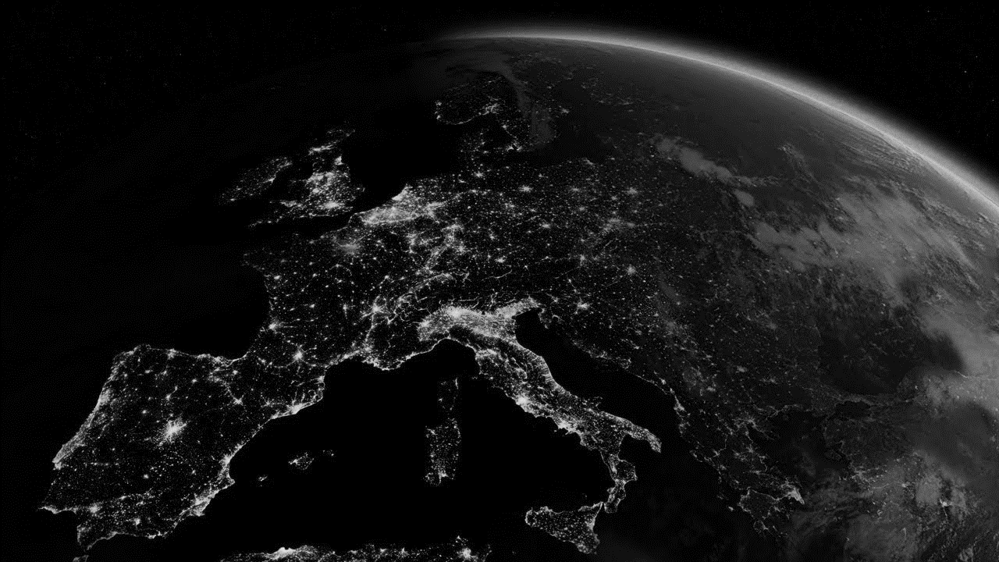
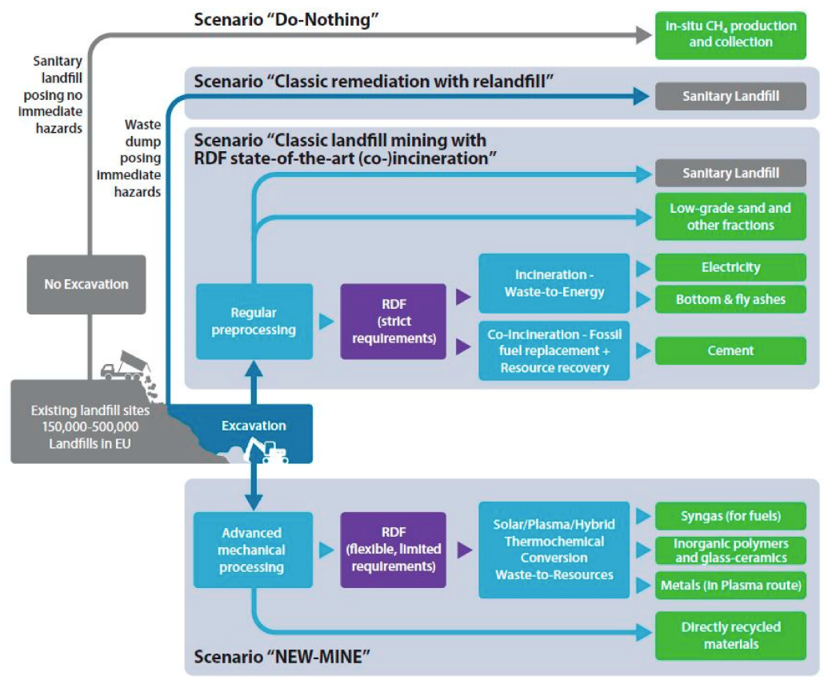
2. Impact of Geologists in Landfill sector : work for waste valorization
  Waste is a resource
  Engaged in the strategy of Landfill Mining (LFM) for recovering critical and other raw materials from landfills and mining waste
Source: The “European Union Training Network for Resource Recovery Through Enhanced Landfill Mining (NEW-MINE)

Slide 8
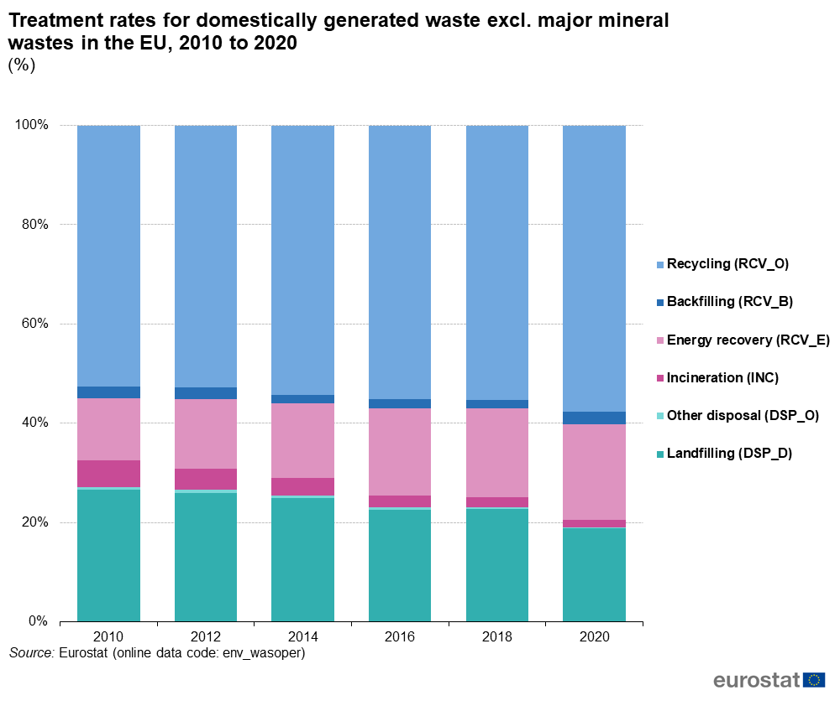
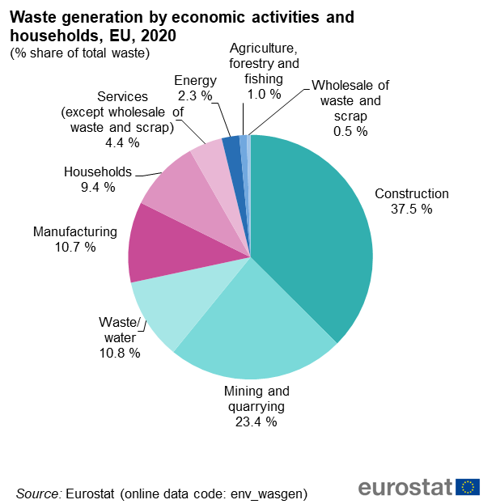
2. Impact of geologists in Landfill sector : work for waste reduction

Slide 9
3. Role of EFG in (No-Sanitary) Landfills
  Promote, among Professionals compliance with EU and Nationals laws and regulations related to the management and operation of landfills, also through application of EFG EurGeol/National Association Ethical and Disciplinary Codes.
  Promote thorough EFG Panel of Experts professional development in the fields interested by landfill management to improve technical aspects and to develop new technologies
  work at different scale with Authorities and other Stakeholders , also thorough EFG National Association, to ensure transferring of know-how and best-case studies.
  Example is transfer know-how and the experiences emerging from this meeting through EFG NAs in Europe and through EFG Partners.

Slide 10
3. Role of EFG in (No-Sanitary) Landfills.
What EFG can do more for EU Community ?
  Share expertise. I ask All Authorities and Representative Bodies in this room, listening in streaming or that will come across this presentation any time in the future to contact and involve EFG in their activities. We are willing to collaborate in Commissions or other Consultive bodies to share our expertise and learn from other’s experiences.
  Be a reference contact. I ask all EU Country Authorities reached by this message to contact and engage discussion with EFG National Association in their Country as a point of contact for reliable Expertise. In Italy I’m aware of the experience of Italy National Council of Geologists in Italy, I’m sure there are other ongoing examples.
  Evvectiveness of above points depends also on your help.

Slide 11
THANK YOU
David Govoni
President-Elect
European Federation of Geologists
efg.president.elect@eurogeologists.eu
Notes:
I can leave it there and answer questions….
Or, if none immediately, I can add a few thoughts on the future. For Geoscience in Europe. And on EFG’s plans.

